Slide 1
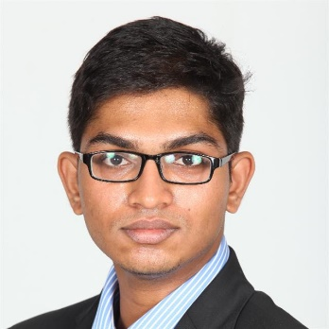
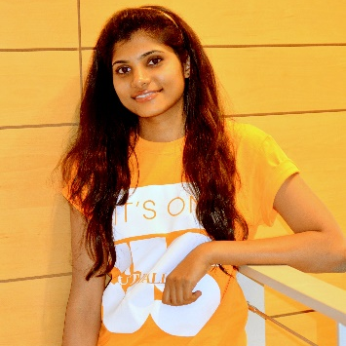
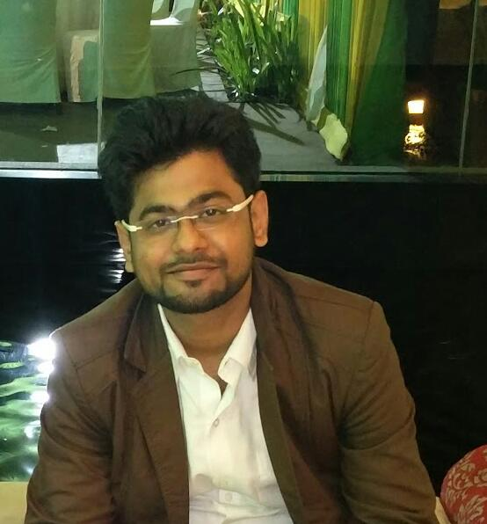
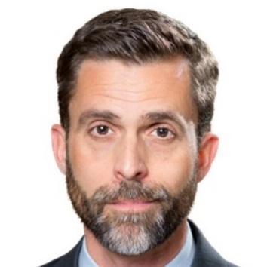
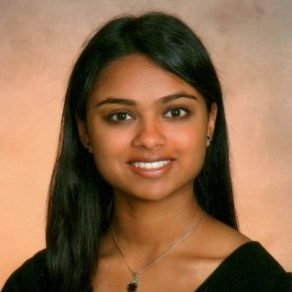
Team Members
Kaushik Moudgalya
Advisory Analyst
Risk & Financial Advisory
Bengaluru, India
Swapna Batta
Specialist Senior
Audit & Assurance
Detroit, Michigan
Rohit Shah
Consultant
Consulting
Mumbai, India
Austin Lasseter
Senior Consultant
Consulting
Arlington, Virginia
Milonee Mehta
Business Technology Analyst
Consulting
Arlington, Virginia

